Slide 1
Final Project
Health Website
VitalNest
Here is the begining of your wellness journey!

Slide 2
Introduction
Our website is designed to be used by all people to help them have a better lifestyle, by doing simple exercises, try healthy recipes, and complete daily tasks that motivate our users to continue their health goals

Slide 3
Why did we choose this topic?
Because:
Health is one of the most essential aspects of life.
It's hard to maintain a balanced lifestyle.
We aim to provide our users with all it needs to improve. their physical and mental well-being.
It encourages healthier habits.

Slide 4
Why we chose the name ``VitalNest``
"Vital"
"Nest"
It was carefully chosen to represent both Life and Care, the name Conveys the idea of a secure and inspiring platform where users can find everything they need to build a better lifestyle
reflects health and energy
Symbolizes comfort, safety, and a supportive space where users can grow their well-being

Slide 5
Table of contents
01
Pages
02
Features
03
Code
04
Outro
Here we talk about our pages!
Our features are unique!
The methods and resources we used in our project
Credits and final touches!

Slide 6
01
Pages
Home page
Login Page
Donations page
Health tips page
Milestones page
Health problems page

Slide 7
First: Home page:
The user's gate to enter our medical website!
It has an introduction and greeting to motivate the user make their life healthier
It contains advices and guides users into the website's pages
Users can reach the Login page and create an account, this enhances their experience

Slide 8
Second: Login page
The place where users can start their well-being journey:
It was developed to provide a secure, user-friendly system, and a comfortable experience
Only write a suitable username and a strong passsword and your account is ready!
No Account Hacking!, your password is encrypted

Slide 9
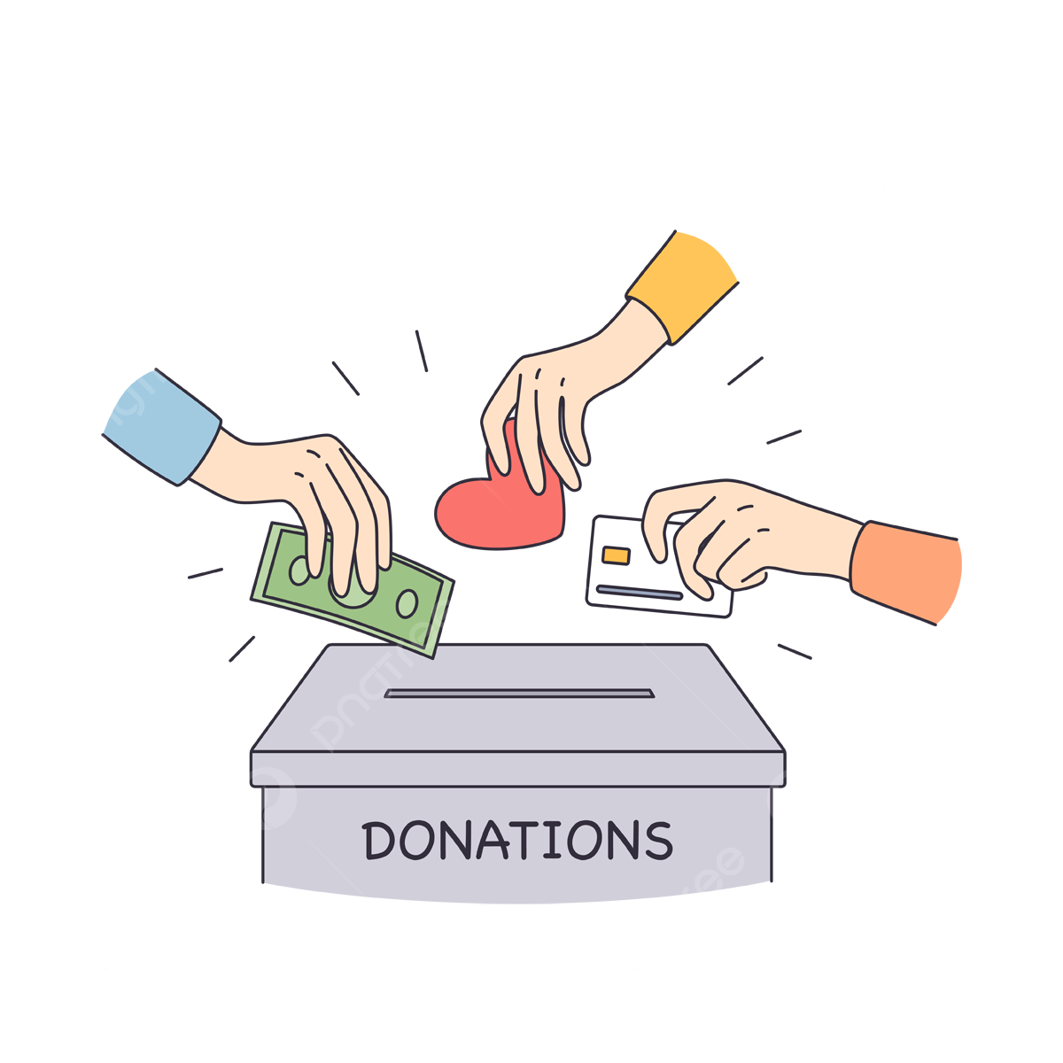
Third: Donation page
A small donation can cause a great difference!
One of the most impactful parts of our project. We integrated the Paymob payment gateway to allow users to donate in Egyptian Pounds.
Why did we make a donation page?
Because we aim to support hospitals, organizations and people in need, making our platform not just technical but socially valuable.
To help people who's unable to get treatment, and to save lives !!

Slide 10
Fourth: Health Tips Page
Ideas
Solutions
Ways to avoid
Professional help
Here is what our Health tips page has to offer!
Tabs for each minor problem!
We make sure you leave this website knowing what to do!
Very detailed description on how to avoid any minor illnesses!
No fear! VitelNest Healthcare will shock your pears!

Slide 11
Fifth: Milestone Page
In VitalNest we want to give you the most enjoyable and challenging experience while improving your health.
On Milestones page, we give you 3 daily challenges To do, every time you finish the 3 challenges - your level will increase by one and the challenges will reset!
It's a fun way to improve your health while doing interesting exercises every day!

Slide 12
Sixth: Health Problems Page
How to solve problems facing us every day?
In VitalNest we provide healthy ways to learn about your problem and how to solve it efficiently. We provide you with necessary information – as well as a chat bot for extra details!

Slide 13
``He who has health, has hope, and he who has hope has everything``
A famous Arabian Proverb

Slide 14
02
Features of VitalNest
Health is wealth.

Slide 15

Features of Vitalnest!
Health tips for any issue!
Explanation for any problem!
Chat bot for more personal conversations!
Milestones and goals to complete everyday!

Slide 16
Our Website offers information about:
Mental Health issues
Physical Health issues
Phsychomatic Health issues
Social Health issues

Slide 17
Our Website allows you to:
Learn how to detect your issue!
Connect with your well being!
Be active and maintain the best version of yourself!

Slide 18
Our Coding for VitalNest
03

Slide 19



We used in making these webpages:
HTML
CSS
JSX
Making the pages, components, elements and to gather all the pages together!
Styling our pages in fonts, images, and making our website comfortable to use!
Defining the element in our pages so we can edit it later!

Slide 20
Future vision and conclusion
Future vision:
In the future, we aim to expand the project by introducing additional modules such as a user dashboard, real-time donation tracking, and integration with mobile applications. We also plan to include enhanced analytics to provide insights into donation behavior, as well as AI-powered recommendations to increase user engagement. Our vision is to deliver an impactful web application that combines technical innovation with social contribution.
Conclusion:
This project gave us the opportunity to apply our technical knowledge in a real-world context.Through the implementation of the login and donation pages, we learned how to design, develop, and integrate critical web components. The combination of React, Paymob, and other tools provided us with valuable experience in building practical web applications. We are proud of the work we have achieved as a team, and we look forward to expanding this project further.

Slide 21


Thank you!
Credits:
Team ``الدنيا ربيع والجو بديع``
Mohamed Tamer
Farida Saeed
Adham Alaa
Nour Salah
Dareen Ehab

